Slide 1
Conspicuous Diffusion: Theorizing How Status Drives Innovation in Electric Mobility
lance noel
Postdoctoral Researcher, Aarhus University
June 7, 2018
EU-SPRI 2018
Notes:
Hello everyone, thank you for giving me an opportunity to present my research. My name is Lance Noel and I am a postdoctoral researcher at Aarhus University. Today I will be presenting on original research about conspicuous diffusion in the realm of electric vehicles.

Slide 2
Introduction
Diffusion of electric vehicles (EVs) are key to low-carbon transition
Obviously, several studies have investigated diffusion and transitions processes of decarbonization
However, current literature that focus on EV is sparse, and the role of status is under-appreciated
Current work focuses on combining status in the diffusion process by introducing a new theory: conspicuous diffusion
Presentation will first define conspicuous consumption & diffusion of innovation, then describe theory of conspicuous diffusion, then apply it to diffusion of EVs in the Nordics
Concludes with policy implications for EVs and theoretical contributions
Notes:
To give a bief overview, this work derives from orginal research on electric vehicles, which are deemed as a key technology to the decarbonization of society
Unfortunately, electric vehicles have faced a variety of challenges, many of which have been thoroughly researched
However, there is litte focus on Evs in diffusion theory, and even less focus on the role of status
To address both diffusion and status of electric vehicles, this work introduces new theory: conspicuous diffusion
Presnetation will define first define the parents of this theory, conspicuous consumption and diffusion of innovation, then define conspicuous diffusion more fully, then apply it to the diffusion of electric vehicles in the Nordic region
Finally, the presentation will conclude with policy iomplications for electric vehicles and academic contributions to diffusion theory

Slide 3
Conspicuous Consumption
Vehicles, historically, have often been associated with status – need to understand status
To incorporate status into diffusion theory, I utilize Veblen’s theory of conspicuous consumption
Conspicuous consumption shows status by conspicuously wasting excess wealth to others, which garners status and respect from society
Includes various forms: conspicuous subservience, conspicuous leisure, conspicuous consumption, conspicuous devotion, etc.
Three key concepts:
1) “Invidious comparison” – upper class strives to distinguish themselves from lower class
2) “Pecuniary emulation” – subsequent lower classes strive to imitate higher classes to garner status
3) “Canon of conspicuous waste” – societal approved conspicuous traditions that distinguished elite from lower class
Recent research has focused on connection between conspicuous consumption and mate attraction
Notes:
Vehicles have historically always been associated with status (first cars seen as an “urban luxury”) and are characterized as among the most visible consumer products - status will thus be necessary to understand diffusion related to any vehicle technology
To do so, I rely on Veblen’s theory of the leisure class, or conspicuous consumption
At the crux of conspicuous consumption is the idea that those with excess wealth show off their richness by conspicuously wasting resources in front of others, garnering respect and status from society
Conspicuous displays can take a variety forms, including conspicuous subservience (wives displaying their servitude to their husbands and avoiding useful labor), conspicuous leisure (displaying the lack of need to work), conspicuous consumption (wasting excess wealth on products and goods), and conspicuous devotion (participating in religious rituals, displaying lack of need to work and excess wealth), among others

Slide 4
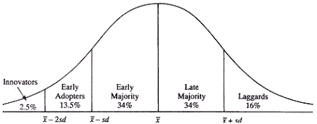
Diffusion of Innovation
Diffusion of innovation explains diffusion process across a population, through communication channel
Five characteristics of an innovation: relative advantage, compatibility, complexity, trialability, observability
Five adopter categories: innovator, early adopter, early majority, later majority, laggards
Five steps in decision process: 1) knowledge, 2) persuasion, 3) decision, 4) implementation, 5) confirmation
Notes:
Secondly, I combine conspicuous consumption with diffusion of innovation in order to explain the diffusion of electric vehicles across a society
Roger’s diffusion of innovation has several sets of fives. First, there are five characteristics of an innovation: (read on slide). Secondly, there are five adopter categories, seen in the figure on the right. Finally, there are five steps to an individual’s consumers decision to adopt or not.

Slide 5
Theoretical Weaknesses/Research Gaps
Conspicuous Consumption | Diffusion of Innovation
-Original theory not comprehensive/testable (there’s no model) -Arguably overly rigid construction of society (emulation should be more lifestyle-focused) -Overly focused on individuals (though there is discussion of institutions) -Despite ready connections, no theoretical connection to diffusion/transition theory -Limited literature on applications to EVs | -Overly focused on individuals, downplays other actors in process, social context -Process relatively static (innovations/preferences evolve during diffusion process) -Limited understanding of motivations behind adoption -While connected to socioeconomics/status, not well explored -Limited literature on application to EVs
For many of these weaknesses, conspicuous consumption and diffusion of innovation can complement each other
-e.g. diffusion gives conspicuous consumption a tangible model, conversely, status helps explain motivation
Notes:
Both conspicuous consumption and diffusion of innovation have various faults and research gaps, which you can read in this table. For example, conspicuous consumption has been criticized for lacking a comprehensive or testable model, and diffusion of innovation lacks an understanding of motivations behind adoptions. Many of these (though not all) can complement each other – diffusion gives conspicuous consumption a tangible and testable model, and conversely inclusion of status can help explain adopter motivation. Rogers even explicitly called for better understanding of status in the latest edition of Diffusion of Innovation.

Slide 6
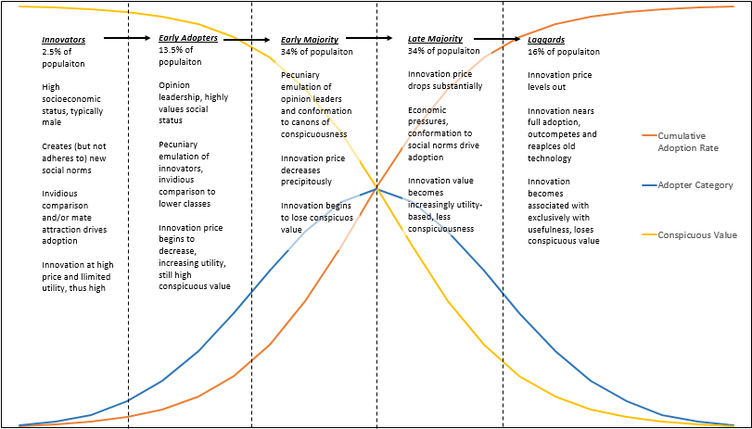
Introducing Conspicuous Diffusion
Notes:
To introduce conspicuous diffusion, I’ll give a short overview of idealized conspicuous diffusion process, based on adopter categories, with blue (adopter category), orange (total adoption) and introducing yellow line (innovation’s conspicuous value)

Slide 7
Introducing Conspicuous Diffusion
Notes:
Step 1: Innovation must conform to canons of conspicuous waste, innovators have money to invidiously distinguish themselves, possibly related to mate attraction
Innovation is at high price, limited utility per $ spent (for cell phone, it was originally incredibly burdensome, expensive but conspicuous, male dominated, or the iPhone – very expensive luxury item)

Slide 8
Introducing Conspicuous Diffusion
Notes:
Step 2: Innovation becomes associated with high status, opinion leaders (who are concerned more about their status) pecuniarily emulate the innovators, also to distinguish themselves from rest of society. Rogers calls this “role models…hand out their stamp of approval” on the innovation, validating the innovation as part of the canons of conspicuousness
Innovation slightly loses conspicuous value, but also slightly decreases in price (original cell phone used beyond business, used in public (Rogers says cell phones used loudly in public to show off)

Slide 9
Introducing Conspicuous Diffusion
Notes:
Step 3: Adoption rate sky rockets as innovation enters early majority, driven primarily by pecuniary emulation and conformation to canons of conspicuousness
Innovation becomes more common among the public, thus begins to lose its conspicuous value, but also price decreases due to mass production (iPhone becomes norm, adoption increases as consumers feel “left out” if they don’t have one, but also becoming less of a luxury

Slide 10
Introducing Conspicuous Diffusion
Notes:
Step 4: Price has decreased substantially – Original cell phones that cost $3,000 now cost only a few hundred – same with iPhones. Adoption partially by economics (late majority and laggards are noted by the lack of socioeconomic capacity to experiment on new technologies), and also by conformation to social norms - not having a cell phone is considered “weird”
Innovation is no longer conspicuous, value is more based on utility per $ spent

Slide 11
Introducing Conspicuous Diffusion
Notes:
Step 5: Final step, price and conspicuous value and price levels out, innovation is near full adoption. Laggards adopt as the new system replaces old technology (cell phones dominate the phone market), becomes cheapest option available
Innovation entirely associated with low-class, loses conspicuous value (no one is impressed by having a cell phone anymore), associated only with utility – Arguably iPhone recommences diffusion process with the new versions of the iPhone every few years – successive generations of conspicuous innovations

Slide 12
Conspicuous Diffusion: Beyond Individuals?
Conspicuous diffusion still suffers from certain drawbacks:
Obviously, not all innovations are conspicuous (e.g. cars vs. energy efficiency measures)
Though may explain non-diffusion of non-conspicuous innovations
Still overly focused on individuals
Less useful for institutional adoptions, particularly complex standards-based innovations
However, institutional role of canons of conspicuousness could expand both theories to include more non-individual actors
Overly reliant on top-down class and economics
Definition of luxury is somewhat nebulous even in Veblen’s time
Lifestyle and identity must be incorporated to have a more nuanced view of conspicuousness
EV might have utility to some (enviro’s) disutility to others (“brown to keep down”)
Capturing more variations of conspicuous allows interpretive flexibility, increases value across lifestyles
Notes:
Before moving onto electric vehicles, I want to acknowledge some flaws and alterations to conspicuous diffusions.
Conspicuous diffusion suffers from three central drawbacks: first, that obviously, not all innovations are conspicuous, such as the car versus home energy efficiency measures (though could explain non-adoption)
Second, the combination of the two theories both overly focus on individuals – thus will be less useful for institutional innovations, especially those that are based on complex standards
But institutions in conspicuous consumptions can be expanded to include non-individual actors in conspicuous diffusion
Finally, conspicuous consumption particularly is overly top-down in class and economics - the definition of luxury is nebulous and depends on the person - [EV example]. More variations of conspicuous value leads to better value across lifestyles

Slide 13
Testing EVs in Conspicuous Diffusion: Scope of study
17 cities across the five Nordic Countries: Denmark, Iceland, Finland Sweden and Norway
227 interviews across 201 organisations
50 focus group participants across 8 focus groups
Team: also includes Benjamin Sovacool (Lead), Gerardo Zarazua and Johannes Kester
OEMS and Transport: | Nissan, Renault, BMW, Volvo, Volkswagen, NEVS, Linkker (bus), HSL, Ruter;
Government: | 10 Federal Ministries, 17 Municipalities (Kommunes)
Utilities & Operators: | Fortum, Virta, Clever, E.ON, Vattenfall, Statkraft, ON Energy, ABB, Elenia, Schneider Electric
TSO and DSO: | Statnet, Energinet, Fingrid, Landsnet, Troms Kraft Nett
Industry: | Nordpool, Siemens, Nuvve, PostNord, ASKO, IBM, Microsoft, PostNorge
Associations: | Dansk Elbil Alliance, Norsk elbilforening, Norsk Petroleuminstitutt, PowerCircle, Finnish Energy
Research & Consulting: | Bellona, Insero, Concito, Ramboll, VTT, Tekes, Sito, NTNU, Enova, Poyry.
Notes:
To test the theory of conspicuous diffusion, I applied it to EV adoption in the Nordic region, of which I draw from a rich dataset. My colleagues and I traveled to 17 cities across the five Nordic countries, conducted 227 expert interviews as well as 8 focus groups, The table shows just a small portion of those interviewed.

Slide 14
Early EVs: Filtering through the Canons of Conspicuousness
Early EVs in the Nordics- Th!nk, Buddy, Better Place – all tried to diffuse by making small city reasonable cars at lower price
Failed to be conspicuous, also failed to diffuse, also led to EVs perceived as inferior
Lacked sexual appeal:
“You have this story in Norway about the car called Th!nk. It looked like a fucking dustbin! It was a plastic can on wheels! Where is the dick factor on that one, you know?” (R196)
EVs stigmatized:
“We are used to electric vehicles being golf carts and kid’s cars or something like that. Actually just changing the mentality for electric vehicles is an uphill battle.” (F1)
All these EVs failed to diffuse more than ~1000 EVs in the Nordics, eventually going out of business
Notes:
The first example are the early Evs in the Nordics, the Think, the Buddy and Better Place – all are marked by their attempt to cheaply bring EVs to mass market by maximizing utility (small city cars). But because this failed to be conspicuous, many viewed these as inferior and unattractive
For example, as one respondent suggested that the Think looks like quote a fucking dustbin unquote. The lack of sex appeal can be seen as a lack of costly signaling – and lack of conspicuous value
As a result, these EVs fail to diffuse, and EVs become associated with inferior technology by consumers

Slide 15
Capturing Conspicuousness: Maximizing Invidious Comparison
Next “round” of EVs – Tesla and Nissan – successfully fit within canons of conspicuousness
Both expensive, not focused on maximizing utility, clear signaling of car’s visibility
Nissan Leaf capitalizes on “conspicuous altruism” – signaling of pro-environmental
Tesla captures more types of conspicuousness (luxury, pro-environmental, mate attraction, etc)
Because of interpretive flexibility and lifestyle fragmentation, conspicuous diffusion would posit Tesla would do better than Nissan
Often credited Tesla & luxury for normalizing EVs:
“Like I said before, the Buddy had almost a laughable image, it’s a nutty car. So I think actually Tesla knowingly or unknowingly has actually contributed to promoting electric vehicles in a very positive way, it’s a dream that come true for a lot of people.” (R234)
Notes:
Moving quickly onto the second “round” of EVs - both the Tesla and the Nissan Leaf fit within the canons of conspicuousness. Both were more expensive than the average vehicle, not overly focused on maximizing utility, clearly singaled the car’s status and visibility
The Leaf focuses on pro-environmental signaling – similar to the Toyota Prius
On the other hand, Tesla capture pro-environmental signaling, while also including traditional luxury and mate attraction, etc.
Because Tesla includes more varieties of conspicuousness, conspicuous diffusion would argue that Tesla would have more social value and diffuse more easily
We see this in the expert’s opinion on the importance of Tesla’s (despite selling the same amount of Leafs, get credited with saving the EV)

Slide 16
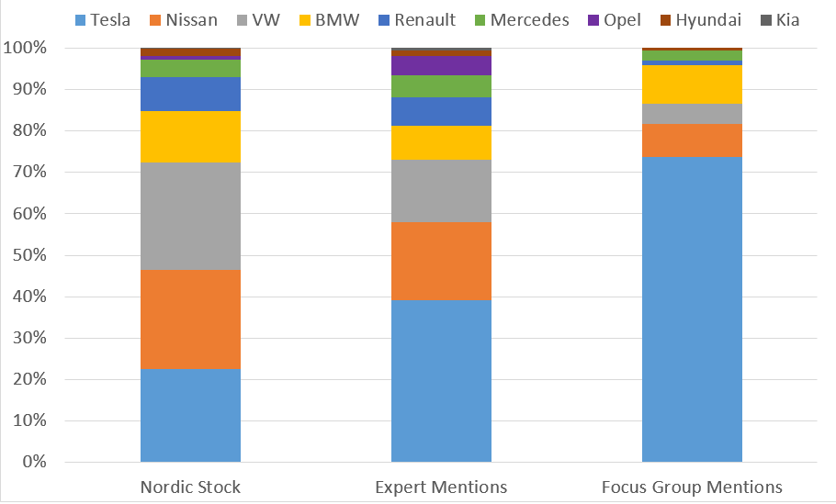
EV Stock vs. Expert/Common Recognition
Notes:
Though Tesla is twice the cost of the Leaf, they made up nearly exactly the same percentage of the Nordic EV stock. However, Experts discussed Tesla at twice the rate of the Leaf, and the focus group nearly exclusively discussed Tesla (over 70% of mentions).

Slide 17
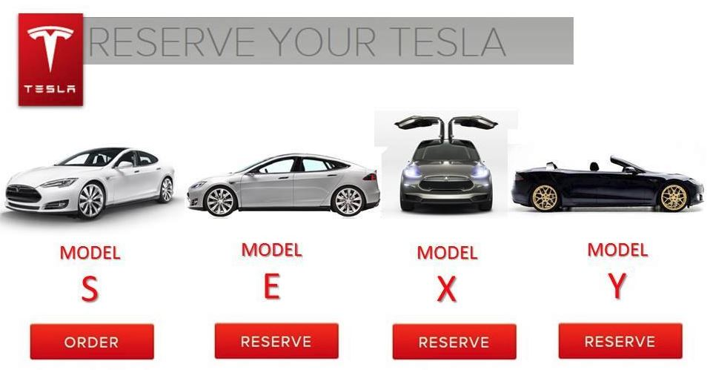
Tesla & Conspicuousness
Unlike previous EVs, Tesla is “sexy”:
“A guy who buys a car, he buys his car with a dick, he doesn’t buy with his brain. Eighty percent, and that’s why Tesla succeeded, because it appeal to his dick. Boom.” (R196)
Also captured more than just pro-environmentalism:
“I will say that it is amazing to see how Tesla has remade EVs in terms of making people aware that electric mobility is actually possible. It’s not something where you have to be eco-religious.” (R106)
But still has environmental signaling:
“And it’s cool and a lot of people that earn a lot of money want to have a Tesla, and it’s not so common that an environmental product are that kind of luxury” (R61)
Notes:
To reiterate, Tesla captures a variety of conspicuousnses. First Tesla’s are S-E-X-Y, as Tesla has underlined with their Model names. This was clear to the experts too, as R196 credits tesla’s success to the appeal to men’s genitilia – but seriously, this fits exactly within the costly signaling theory of conspicuous consumption
But, also captured other forms, including environmental signaling and more

Slide 18
Nissan: Halfway to Conspicuousness
Nissan Leaf did not fare as well in our interviews, though it fits partially within conspicuous consumption, similar to the Toyota Prius (pro-environmental signaling)
However, compared to Tesla, it is somewhat of a half-measure, and comes off comparatively worse
For example, many experts who drove Nissan Leafs felt comparative shame:
“I’m driving a Nissan Leaf. I’m waiting for the Tesla Model 3, it’s good-looking car. The Nissan is ugly as hell but, yeah, you need cool cars you’re not ashamed of.” (R42)
Other experts suggested there was no status value of a Leaf:
“Cars are status symbols. If you are rich enough to buy a Tesla, it’s okay. But there is nothing prestigious about a Nissan Leaf.” (R95)
Recognition among consumers was very low (8% of focus group mentions, compared to 24% stock):
“The Nissan Leaf? I think it is, but I think it is a hybrid… let’s say Tesla, because everybody knows Tesla.” (F3)
Notes:
On the other hand, Nissan only focused on pro-environmental signaling, and as compared to Tesla is somewhat of a half-measure, and came off as comparatively worse.
For example, experts with Leafs felt comparative shame, and wished they had the money for a Tesla. Other experts suggested that the Nissan Leaf failed because there was “nothing prestigious” about it
As a result, recognition among consumers was very low (comparing 8% of mentions to 24% of Nordic EV stock), and uncertainty whether it’s even really a full electric vehilce

Slide 19
Beyond Tesla: Pecuniary Emulation & Developing New Social Norms
Tesla has created a new social norm on the viability of reputably owning an EV
Drives pecuniary emulation, especially within Norway (arguably in Early Adopter stage)
One can see the beginning of loss of conspicuous value in Norway:
“I think in the beginning it was like ‘wow it’s a Tesla’, and then when you come to Oslo, and you see a Tesla on every corner, you’re like ‘I guess it’s not that special.’” (R81)
In addition, Tesla was also credited with forcing other OEMs to react to the new social norm by investing in EVs:
“We could see that Tesla’s success changed the automobile company’s priorities big time, because they knew Tesla was coming but didn’t believe they would be a success. So that has gone all the way to the boardrooms of BMW and forced them to make better EVs. So they went from being against EVs to wanting to be a part of the solution. They are serious about it and now developing good cars.” (R109)
Also argued by focus group:
“And you see of course these companies like Tesla who have been in the forefront, and now you see other more reactionary car. Volkswagen just announced today that they want to switch to electrical.” (F2)
Notes:
Moving to the next steps, Tesla has arguably created a new social norm on the reputability of owning an EV
In Norway, where EV adoption has reached the next stage, some have noted the gradual loss of conspicuous value of Tesla’s.
But because Tesla has created a new “fad” and increased pecuniary emulation, other OEMs reacted to tesla by introducing their own Evs, as argued by both the experts and consumers in the focus group

Slide 20
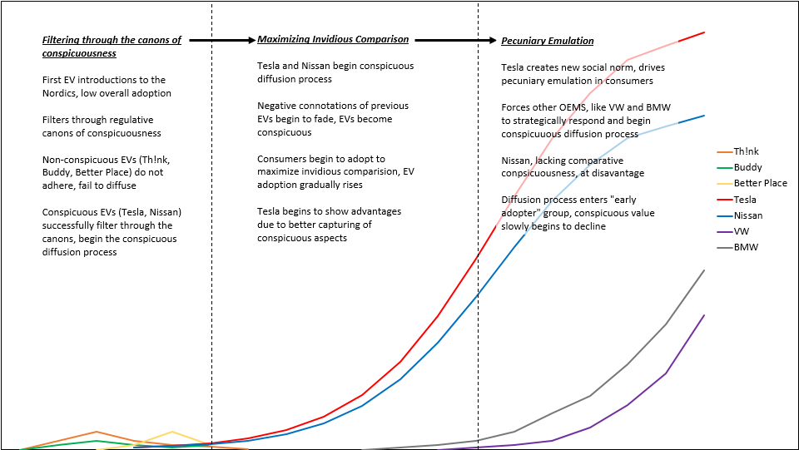
Summary of EVs in Nordics in Conspicuous Diffusion
Notes:
To summarize, this graph shows an idealized diffusion of the three stages of Nordic EVs.
First, Think/Buddy/Better Place do not adhere to conspicuous consumption, fail to diffuse
Second, Tesla and Nissan adhere to conspicuous consumption and begin the conspicuous diffusion process – Tesla has an advantage because it captures more conspicuousness
Third, other OEMs strategically respond as EVs become part of the canons of conspicuousness and others pecuniarily emulate

Slide 21
EV Policy Implications
Conspicuous diffusion dictates that new innovations like EVs diffuse more naturally if priced expensively and composed of luxury
Governments should avoid “punishing” luxury innovations that are good for society, like Tesla, and instead view it as the first step towards full adoption
Instead of taxing luxury EVs, a progressive incentive would be better suited, but also in tandem with policies that increase the visibility and conspicuous value of the Tesla (e.g. free driving in the bus lane, or free parking)
Non-intuitively, automakers may want to increase the price of their EVs, and lean into the luxury aspects of EVs – might also better fit business models of early innovations where development costs are high and hard to sell at a loss
Automakers should also increase focus on luxury advertising – increases visibility and establishes luxury value of the EV
Finally should also consider other forms of conspicuous consumption (blatant benevolence, mate guarding)
Notes:
Two more slides very quickly: First EV policy implications. If you agree with the conspicuous diffusion theory, then EV policy changes significantly. First, governments should not be so concerned by the luxury innovations such as Tesla (and arguably the Leaf), and instead view it as a first step towards full adoption.
On the other hand, a more valuable policy may be increasing the visibility of the Tesla/other EVs, such as free parking or free bus lane access – it’s hard to be jealous of EVs if you don’t see them and you don’t know what they are.
For industry, automakers may want to focus less on the “everyman EV” and instead lean into the luxury aspects of the EV, and non-intuitively increase their price

Slide 22
Theoretical Contributions
Conspicuous diffusion presents a more comprehensive and tangible theory of conspicuous consumption
Also elaborates on the role of status and socioeconomics in the diffusion of innovation
Future diffusion research should consider including conspicuous consumption characteristics (particularly when the innovation is especially visible in society) when predicting future adoption, and also past failures
Future research should also focus on the role of institutions in conspicuous diffusion (and technological determinism) to flesh out conspicuous diffusion beyond the focus of individual actors
Conspicuous diffusion can also be incorporated into other theories, like the multi-level perspective
In sum, we show that diffusion of innovation is more than cost or discourse, but status, luxury and sexiness
Notes:
Finally, conspicuous diffusion offers several academic contributions. First, it gives a more tangible theory of conspicuous consumption. Secondly, it offers a more complete and novel explanation of the role of status and socioeconomics in diffusion theory
Future diffusion research should consider including conspicuous characteristics when forecasting adoption
Future research should also investigate the role of institutions to bring the focus of the theory beyond only individuals
In conclusion, we show that diffusion of innovation is more than cost or discourse, but rather status, luxury and sexiness

Slide 23
Lance Noel
Mobile: +45 6196 8669
lnoel@btech.au.dk
@LanceV2G
Notes:
If they want to know more about the results of research, papers, contact for collaboration, etc.

