Slide 1
RTO_s as emerging nodes of quadruple helix innovation systems? Lessons from investigating DEEP institutionalisation of responsibility oriented practices @ Fraunhofer
Philine Warnke, Andreas Röß Fraunhofer ISI

Slide 2
Overview
Rationale I: Need to align innovation system and RRI approach
Rationale II: Need to open up innovation system approach
Zoom in on RTOs
Example situation at Fraunhofer
(Deep institutionalization as a framework concept)
Deep institutionalisation of RRI at Fraunhofer
Conclusions

Slide 3
Rationale of linking RRI and Innovation Systems
The innovation system approach still underpins many R&I policy interventions
therefore If RRI aims at “empowering social agency in technological decision-making (Stilgoe et al. 2013)” the innovation system heuristics seems a relevant inroad
Connect to attempts to revisit the innovation system concept in the light of more recent perspectives on innovation, especially STS perspectives on social shaping of technology

Slide 4
Moving from boxes ...
Demand
Consumers (final demand)
Producers (intermediate demand)
Framework Conditions
Financial environment; taxation and incentives; propensitiy to innovation and entrepreneurship; mobility
Industrial System
Education and Research System
Political System
Large companies
Professional education, training
Government
Intermediaries
Research institutes;
Brokers
RTOs
Mature SMEs
Higher education and research
Governance
New, technology based firms
Public sector research
RTD policies
Infrastructure
E. Arnold, S. Kuhlmann, B. van der Meulen: „A singular Council. Evaluation of the Research Council of Norway“ 2001, p. 13
Banking, venture capital
IPR and information
Innovation and business report
Standards and norms

Slide 5
... to ever more boxes ...
Demand
Framework Conditions
Financial environment; taxation and incentives; propensity to innovation and entrepreneurship; mobility ...
Consumers (final demand)
Producers (intermediate demand)
Social/relational/ Cultural Capital
User Innovators
?
Industrial System
Innovation mediators (clubs, associations, trade unions)
Education and Research System
Political System
Large companies
Professional education and training
Government
Intermediaries
Research institutes
Brokers
Collaborative Innovators
MOOCS
Other policies (environment, transport …)
Mature SMEs
Higher education and research
Governance
Non R&D intense firms
New, technology- based firms
Public sector research
RTD policies
?
Social Innovators
Infrastructure
Banking, venture capital
IPR and information
Innovation and business support
Standards and norms
Co-Creation Platforms
Crowdfunding
Philanthropists (private & corporate)

Slide 6
Culture
Social and relational capital
Values, lifestyles, attitudes
to (responsible) fluxes ...
Institutions
IPR, standards, norms
Innovation Frameworks
Education
Public and private educators on all levels
Society
Consumers, User Innovators
Social Entrepreneurs, Collaborative innovators, citizens
Mediators
Clubs, associations, trade unions, cluster, NGOs, RTO
Innovation Supply and Demand
Business
Firms of all sizes and sectors generating and demanding innovation
Public Sector
PS actors generating and demanding innovation
Cities, hospitals, administrations …
Research
Universities, RTOs, citizen scientists ...
Policies
Ps influencing innovation framework conditions (RTI) and demand patterns (energy, environment, mobility, health, defense, home …)
Innovation Input
Financers
Banks, venture capital, philanthropists, crowds
Infrastructure
ICT, Internet, databases, Co-Creation Platforms …

Slide 7
Zooming in
on RTOs

Slide 8
From I/R mediator ...
Demand
Consumers (final demand)
Producers (intermediate demand)
Framework Conditions
Financial environment; taxation and incentives; propensitiy to innovation and entrepreneurship; mobility
Industrial System
Education and Research System
Political System
Large companies
Professional education, training
Government
Intermediaries
Research institutes;
Brokers
RTOs
Mature SMEs
Higher education and research
Governance
New, technology based firms
Public sector research
RTD policies
Infrastructure
E. Arnold, S. Kuhlmann, B. van der Meulen: „A singular Council. Evaluation of the Research Council of Norway“ 2001, p. 13
Banking, venture capital
IPR and information
Innovation and business report
Standards and norms

Slide 9
to (potential) boundary spanners/catalysts
Culture
Social and relational capital
Values, lifestyles, attitudes
Institutions
IPR, standards, norms
Innovation Frameworks
Education
Public and private educators on all levels
Society
Consumers, User Innovators
Social Entrepreneurs, Collaborative innovators, citizens
Mediators
Clubs, associations, trade unions, cluster, NGOs, RTO
Innovation Supply and Demand
RTO
Public Sector
PS actors generating and demanding innovation
Cities, hospitals, administrations …
Business
Firms of all sizes and sectors generating and demanding innovation
Research
Universities, citizen scientists, RTOs ...
Policies
Ps influencing innovation framework conditions (RTI) and demand patterns (energy, environment, mobility, health, defense, home …)
Innovation Input
Financers
Banks, venture capital, philanthropists, crowds
Infrastructure
ICT, Internet, databases, Co-Creation Platforms …

Slide 10
What does it mean for RTOs in practice?
Background: JERRI Joining efforts for responsible research and innovation. TNO and Fraunhofer advancing RRI in their organizations together RRI: Capacity to engage into a continuous process with all relevant societal actors in a reflexive manner to co-create solutions for societal needs
Theoretical Framework: Deep Institutionalisation of RRI (Randles 2014, 2017) :
“effective transformation towards a set of articulated normative goals embedding values into practices and processes and orienting action towards those goals.” p. 32.

Slide 11
Deep Institutionalisation @ Fraunhofer Conceptual Starting Point
4-way Typology of Deep Institutionalisation (Sally Randles)
Evolution of dominant narratives
what are the dominant storylines about what we do and why?
A maturation process (emergence/maturity/resilience)
How deeply is it integrated into daily routines/organisational culture?
Systemic consolidation
do we use common concepts to think about it across the organisation?
are there impulses overflowing into other spheres?
Vertical multi-level alignment
how coherent are governance levels within the organisation and with its external environment;
how well do we cope with multiple institutional logics/conflicting goals.

Slide 12
Investigation
Document analysis as well as interviews and workshops with actors in the key RRI dimensions within Fraunhofer and immediate environment (eg.. BMBF) (ongoing)
preliminary findings ...

Slide 13
Results I/IV Fraunhofer and the six grand narratives of rri

Slide 14
Results II/IV
 | Open Access | Gender Equality | Ethics | Societal Engagement
State of the maturation process | Mature | Resilient | Between emergence and maturity | Emergent
Systemic Consolidation | Pervasive interdepending system with over-flowing | Taken-for-granted un-reflexive institutional logic | Niche integrated normative networks | Ad-hoc experiments
Vertical Alignment | High resonance and active influence on the context | High pressure from the context but difficulties in realization | Medium pressure from context, resonance depends on specific research area | Low pressure and little interaction with the context

Slide 15
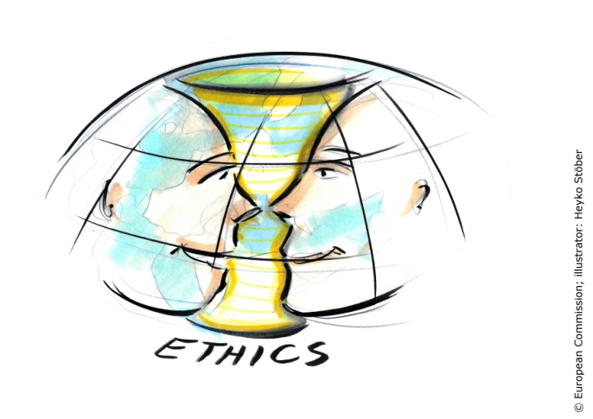
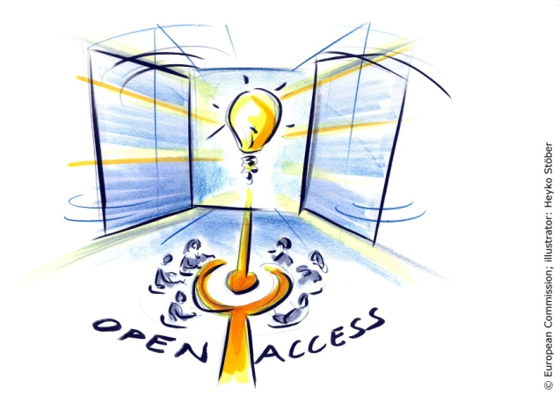
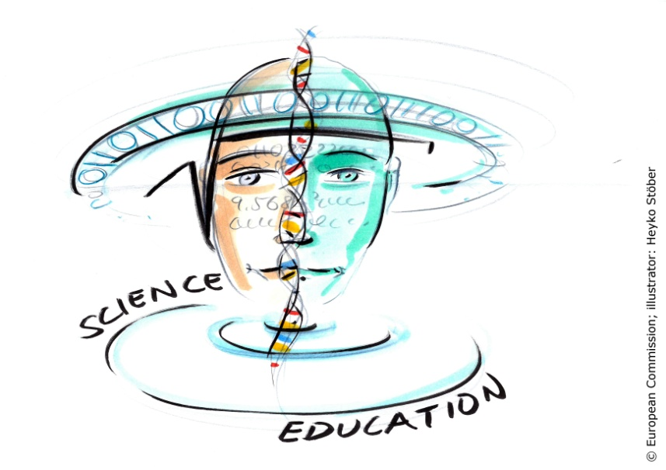
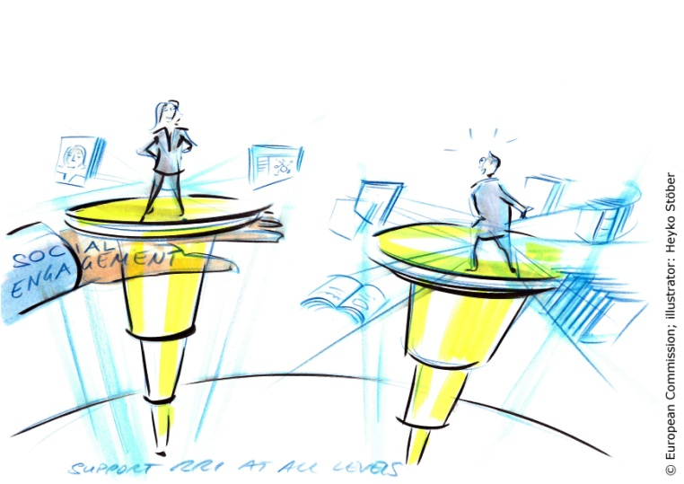
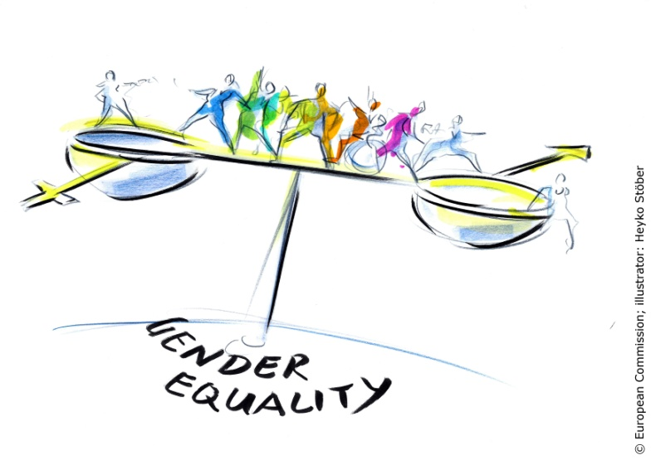
Results III/IV „Its the culture, stupid!“
Ethics: External pressure, first central level initiatives, several formal guidelines, bottleneck Integration into everyday practices
Open Access: Ambitious, outgoing strategy towards open science, bottleneck diffusion into everyday practices
Science Education: Strong HR marketing, no broader concept
Societal Engagement: Decentralized individual activities
Gender (equality): Well-developed institutions and measures in place across the organisation, effects lagging behind ambitions, bottleneck diffusion into organizational culture

Slide 16
Results IV/IV: Three challenging key enablers
Intra-organisational level
Aligning RRI with the intrinsic motivation of the organisation e.g. excellence in Fraunhofer case (more important than direct “extra” incentives)
Build up RRI competences on the right level
Environment level
RRI educated staff (most important reflexive capacity)
RRI evidence
Actor level
Create space & capacity for reflexivity

Slide 17
Conclusions
Interpretation of RRI as ability to play an active role in a reflexive innovation system works in principle, the RRI dimensions can be seen as ability to interact with the flux
Deep institutionalization framework enables a more differentiated understanding of the situation especially tensions between formal advancement and cultural embedding
a few additions useful e.g. distinguishing inside out and outside in resonance with the environment (relevant for powerful organisations that are also drivers)
Need to differentiate different dimensions for the analysis
BUT crosscutting enablers & barriers are emerging

Slide 18
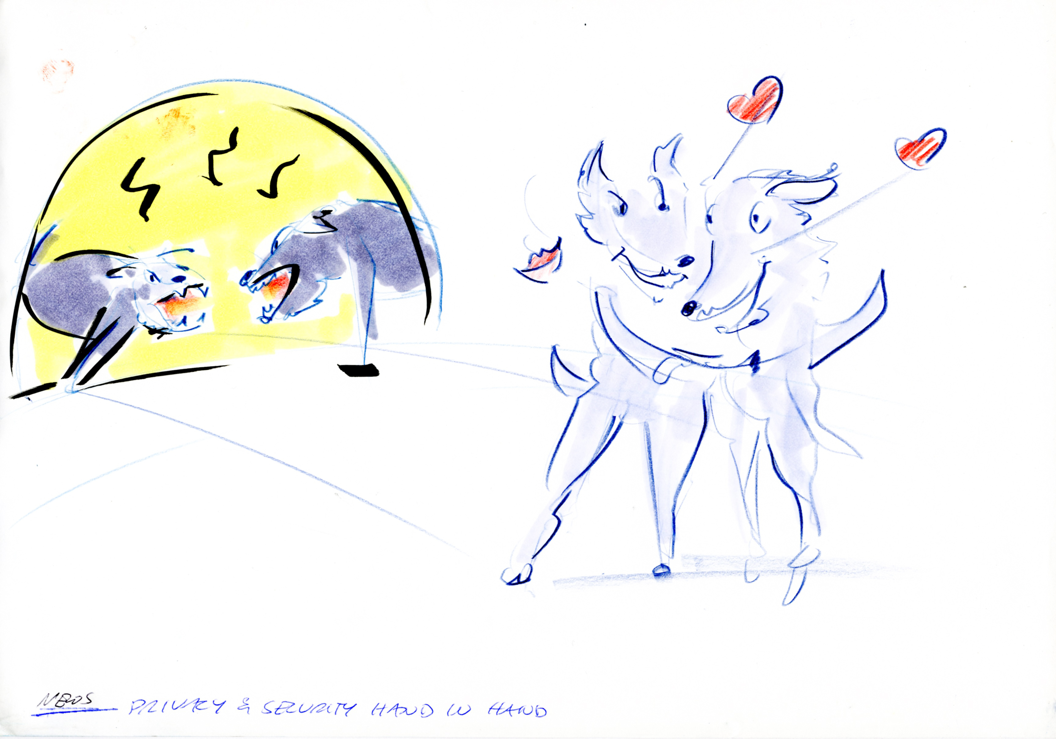
Thank You!
excellence
responsibility
http://www.jerri-project.eu/jerri/

